Slide 1


Churn Predictor: Decoding Customer Behavior
Welcome to the Churn Predictor project, where we explore the fascinating world of customer behavior analysis and predictive modeling. Our mission is to understand and forecast customer churn using cutting-edge data science techniques. This notebook guides you through the process of uncovering insights hidden in customer data to predict and prevent churn.
As we embark on this data-driven journey, remember: "In data we trust, but insights we must!" Let's dive in and unlock the stories concealed within our dataset, aiming for accurate models and profound insights that can transform customer retention strategies.
by Shashank Pandey

Slide 2
Data Exploration and Preprocessing
Our journey begins with exploring and preparing the data. We load the telco customer churn dataset and perform initial analysis to understand its structure and contents. The dataset contains various customer attributes such as gender, tenure, services subscribed, and monthly charges.
Key preprocessing steps include handling missing values, converting data types, and scaling numerical features. This ensures our data is in the optimal format for machine learning algorithms.
Load Data
1
Import the telco customer churn dataset and display basic information.
2
Check Missing Values
Identify and handle any null or missing data points in the dataset.
Data Type Conversion
3
Convert categorical variables to numerical format for model compatibility.
4
Feature Scaling
Normalize numerical features to ensure equal weight in model training.

Slide 3
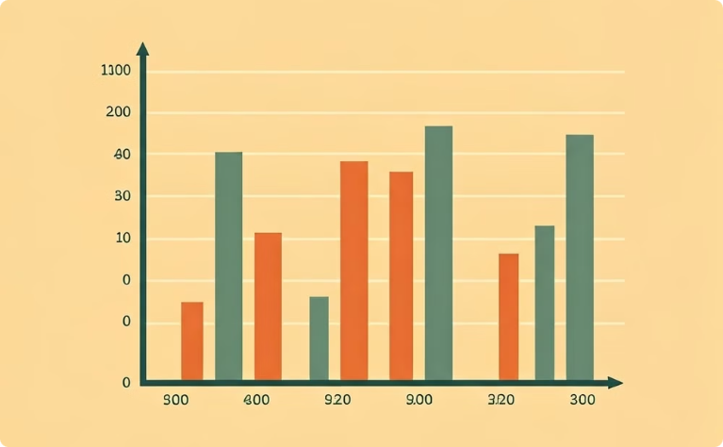
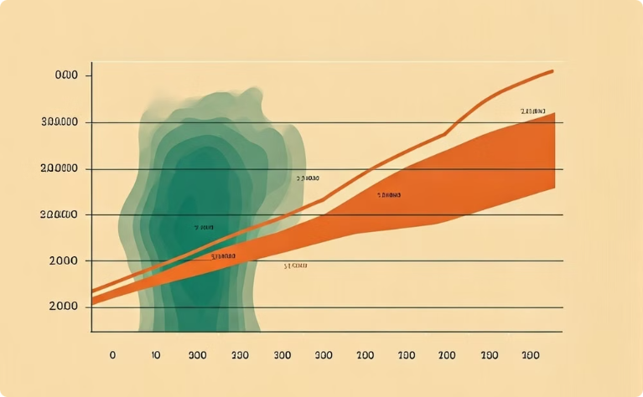
Exploratory Data Analysis
Exploratory Data Analysis (EDA) is crucial for understanding the underlying patterns and relationships in our dataset. We visualize the distribution of key variables and examine correlations between features.
The churn rate distribution reveals the balance between churned and retained customers. We also create a correlation heatmap to identify which features are most strongly associated with churn.
Churn Distribution
Correlation Heatmap
Visual representation of the proportion of churned vs retained customers.
Illustrates the strength of relationships between various customer attributes and churn.

Slide 4
Feature Engineering and Selection
Feature engineering is the art of creating new, meaningful features from existing data to improve model performance. We create interaction features such as 'tenure_by_monthly' to capture more complex relationships.
Feature selection helps identify the most important predictors of churn. We use techniques like Random Forest feature importance to rank features based on their predictive power.
Interaction Features
Aggregate Features
Create new features by combining existing ones, such as tenure multiplied by monthly charges.
Develop features that summarize multiple attributes, like total number of services subscribed.
Feature Importance
Dimensionality Reduction
Use machine learning algorithms to rank features based on their impact on churn prediction.
Apply techniques like PCA to reduce the number of features while retaining important information.

Slide 5
Model Development and Evaluation
We develop and evaluate several machine learning models to predict customer churn. Our approach includes traditional algorithms like Logistic Regression and Random Forest, as well as advanced techniques such as XGBoost and Neural Networks.
Each model is trained on a portion of the data and evaluated using metrics such as accuracy, precision, recall, and F1-score. We also use cross-validation to ensure robust performance estimates.
Logistic Regression
Random Forest
XGBoost
Simple but interpretable model serving as a baseline for churn prediction.
Ensemble method that captures complex relationships in the data.
Advanced gradient boosting algorithm known for high performance in various tasks.

Slide 6




Ensemble Methods and Advanced Techniques
To further improve our predictive power, we explore ensemble methods that combine multiple models. Techniques like Voting Classifiers, Bagging, and Stacking are implemented to leverage the strengths of different algorithms.
We also delve into advanced techniques such as neural networks, which can capture intricate patterns in the data. These methods often provide a boost in performance over individual models.
Voting Classifier
Bagging
Stacking
Neural Networks
Combines predictions from multiple models through majority voting or averaging.
Creates multiple subsets of the data to train diverse models and aggregate their predictions.
Uses predictions from base models as inputs to a meta-model for final predictions.
Deep learning models capable of learning complex non-linear relationships in the data.

Slide 7
Time Series Analysis of Churn Trends
To gain insights into the temporal aspects of customer churn, we conduct time series analysis. Using techniques like ARIMA (AutoRegressive Integrated Moving Average) and SARIMA (Seasonal ARIMA), we model and forecast churn rates over time.
These models help identify seasonal patterns and trends in churn behavior, allowing businesses to anticipate periods of higher churn risk and take proactive measures.
Data Preparation
Model Training
Aggregate churn data into time series format, typically monthly or quarterly intervals.
Fit the selected model to historical churn data, optimizing parameters for best fit.
1
2
3
4
Model Selection
Forecasting
Choose between ARIMA for non-seasonal data or SARIMA for data with seasonal patterns.
Use the trained model to predict future churn rates and identify potential spikes.

Slide 8
Actionable Insights and Recommendations
The culmination of our analysis yields actionable insights to reduce customer churn. By identifying the most significant predictors of churn, we can recommend targeted retention strategies.
Key findings might include the impact of contract type on churn risk, the importance of customer service interactions, or the role of pricing in customer retention. These insights empower businesses to implement data-driven strategies for improving customer loyalty and reducing churn.
1
Personalized Offers
2
Proactive Outreach
Develop tailored promotions for high-risk customers based on their specific attributes and usage patterns.
Implement targeted communication strategies for customers showing early signs of potential churn.
3
Service Improvements
4
Loyalty Programs
Address common pain points identified in the analysis to enhance overall customer satisfaction.
Design or refine loyalty programs to incentivize long-term customer retention and engagement.

